Slide 1
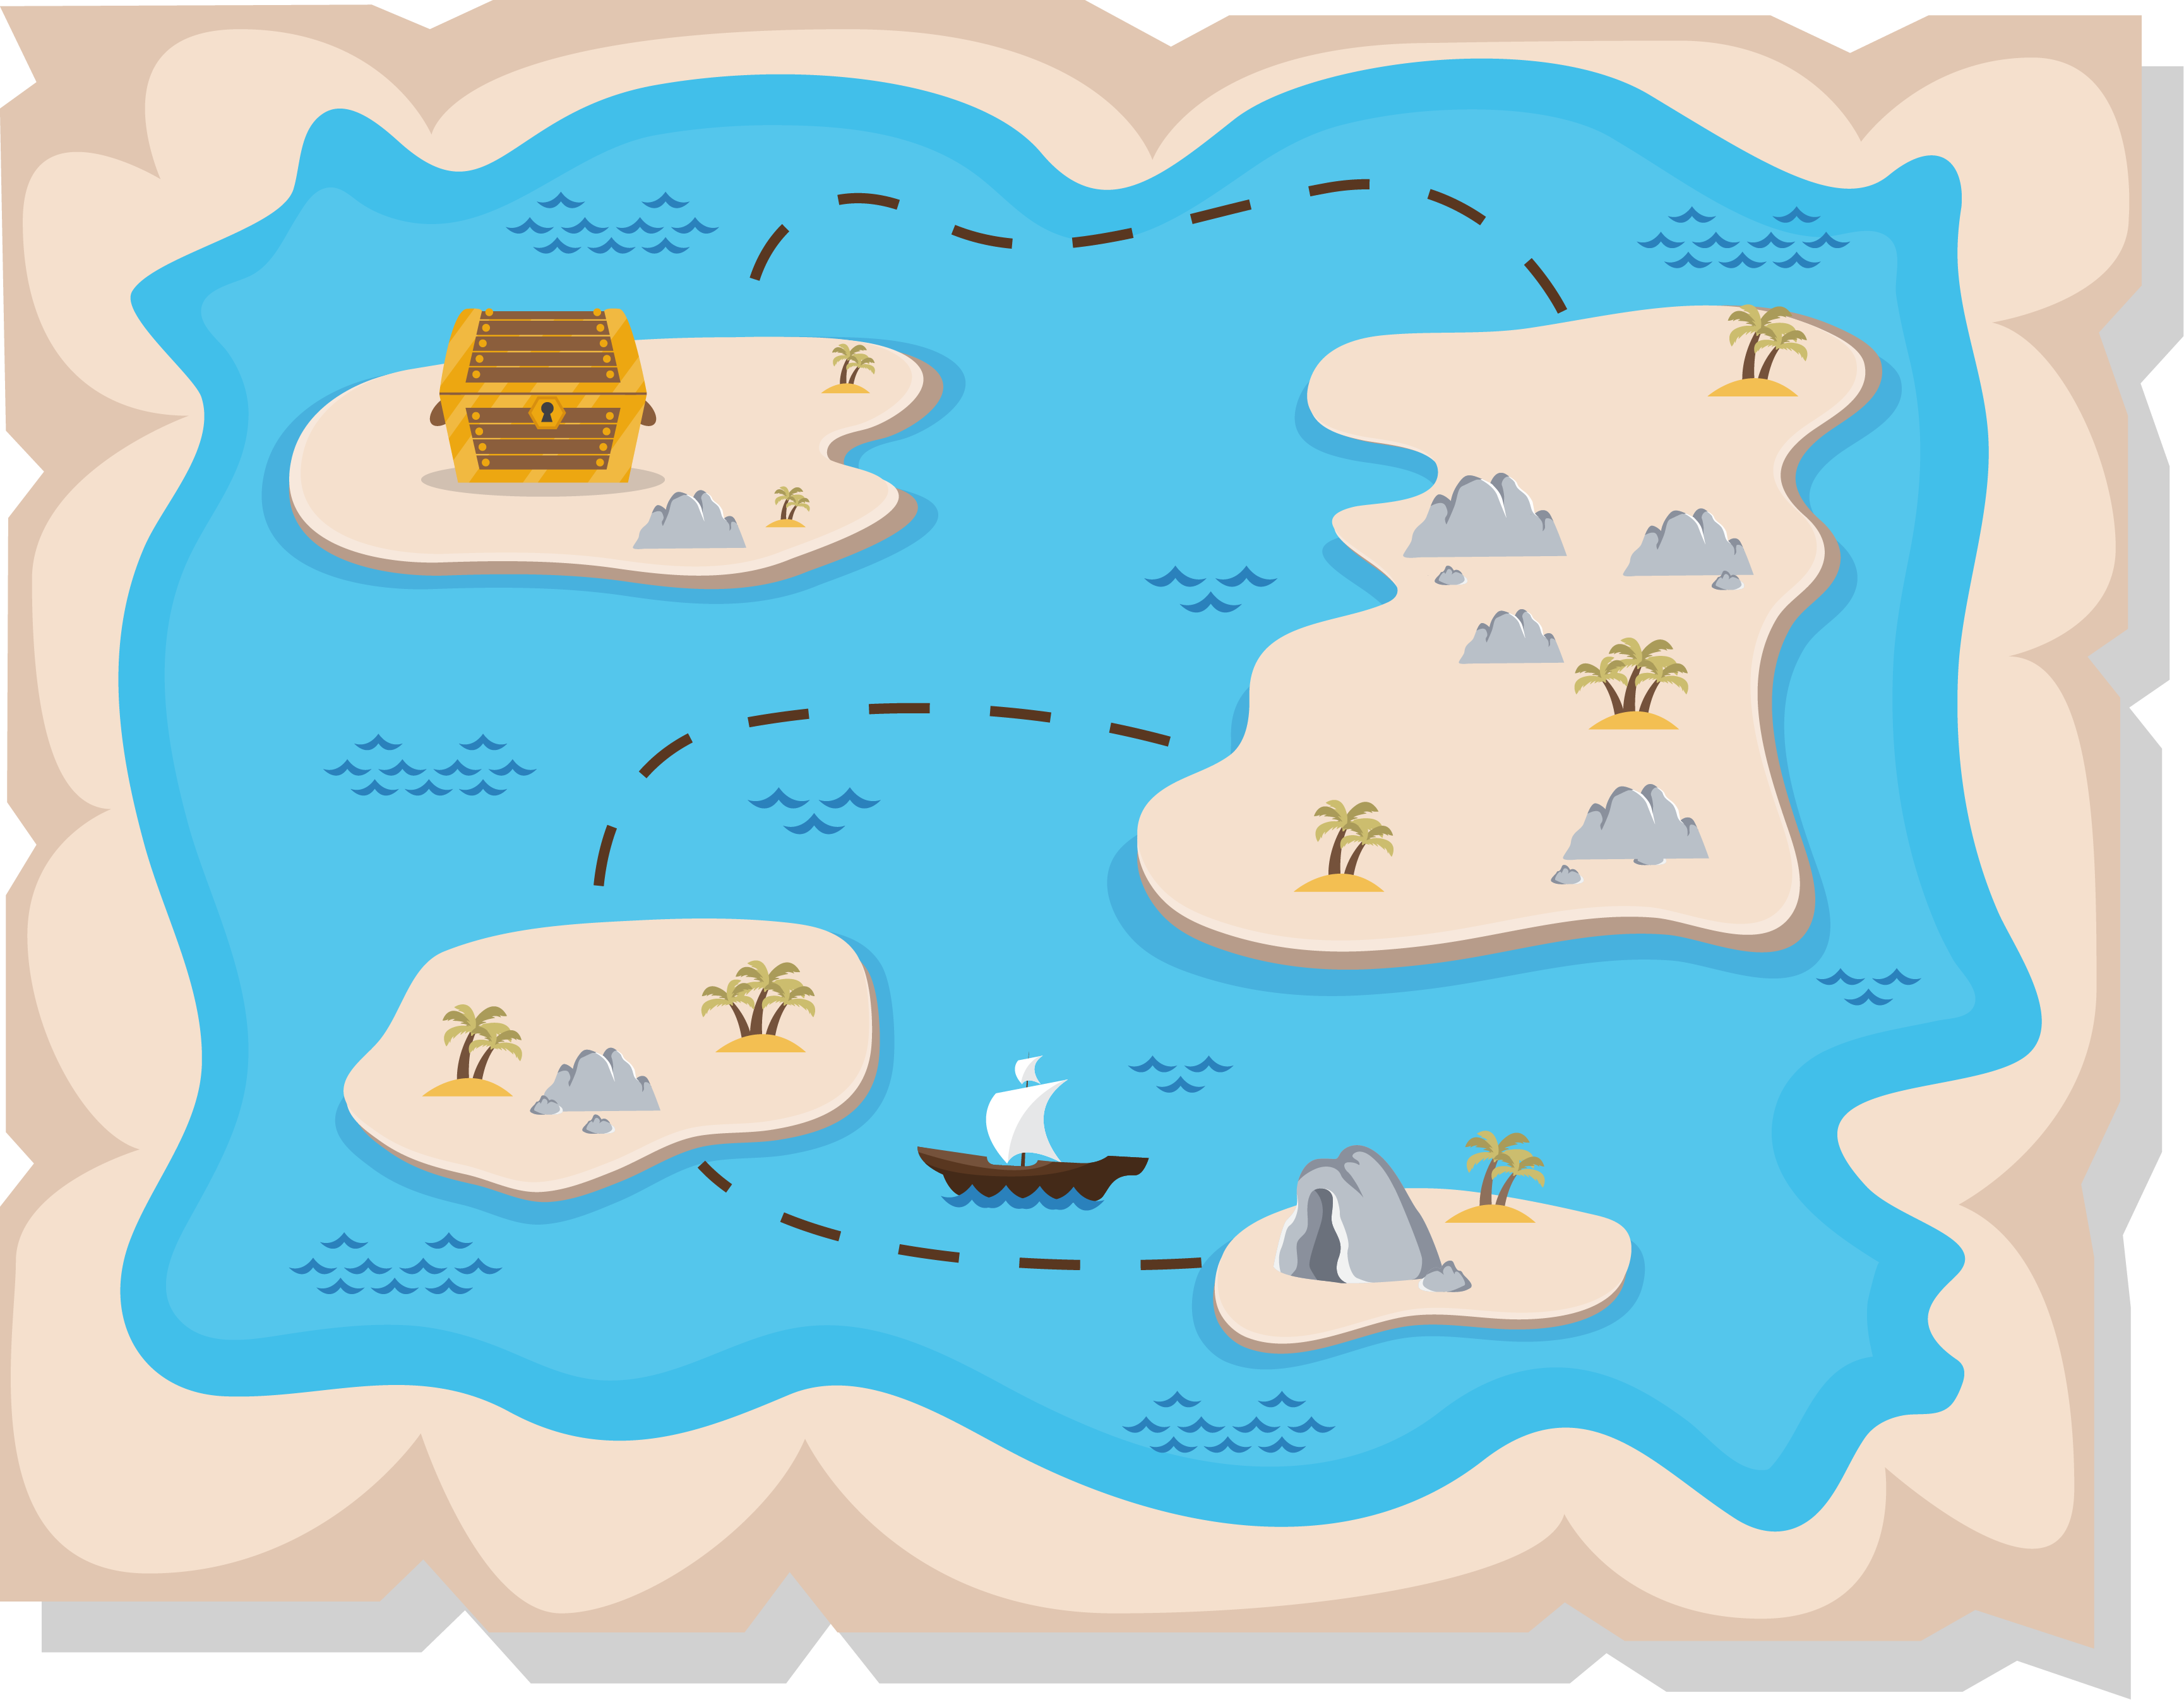
Lesson 2:
Treasure Hunt

Slide 2
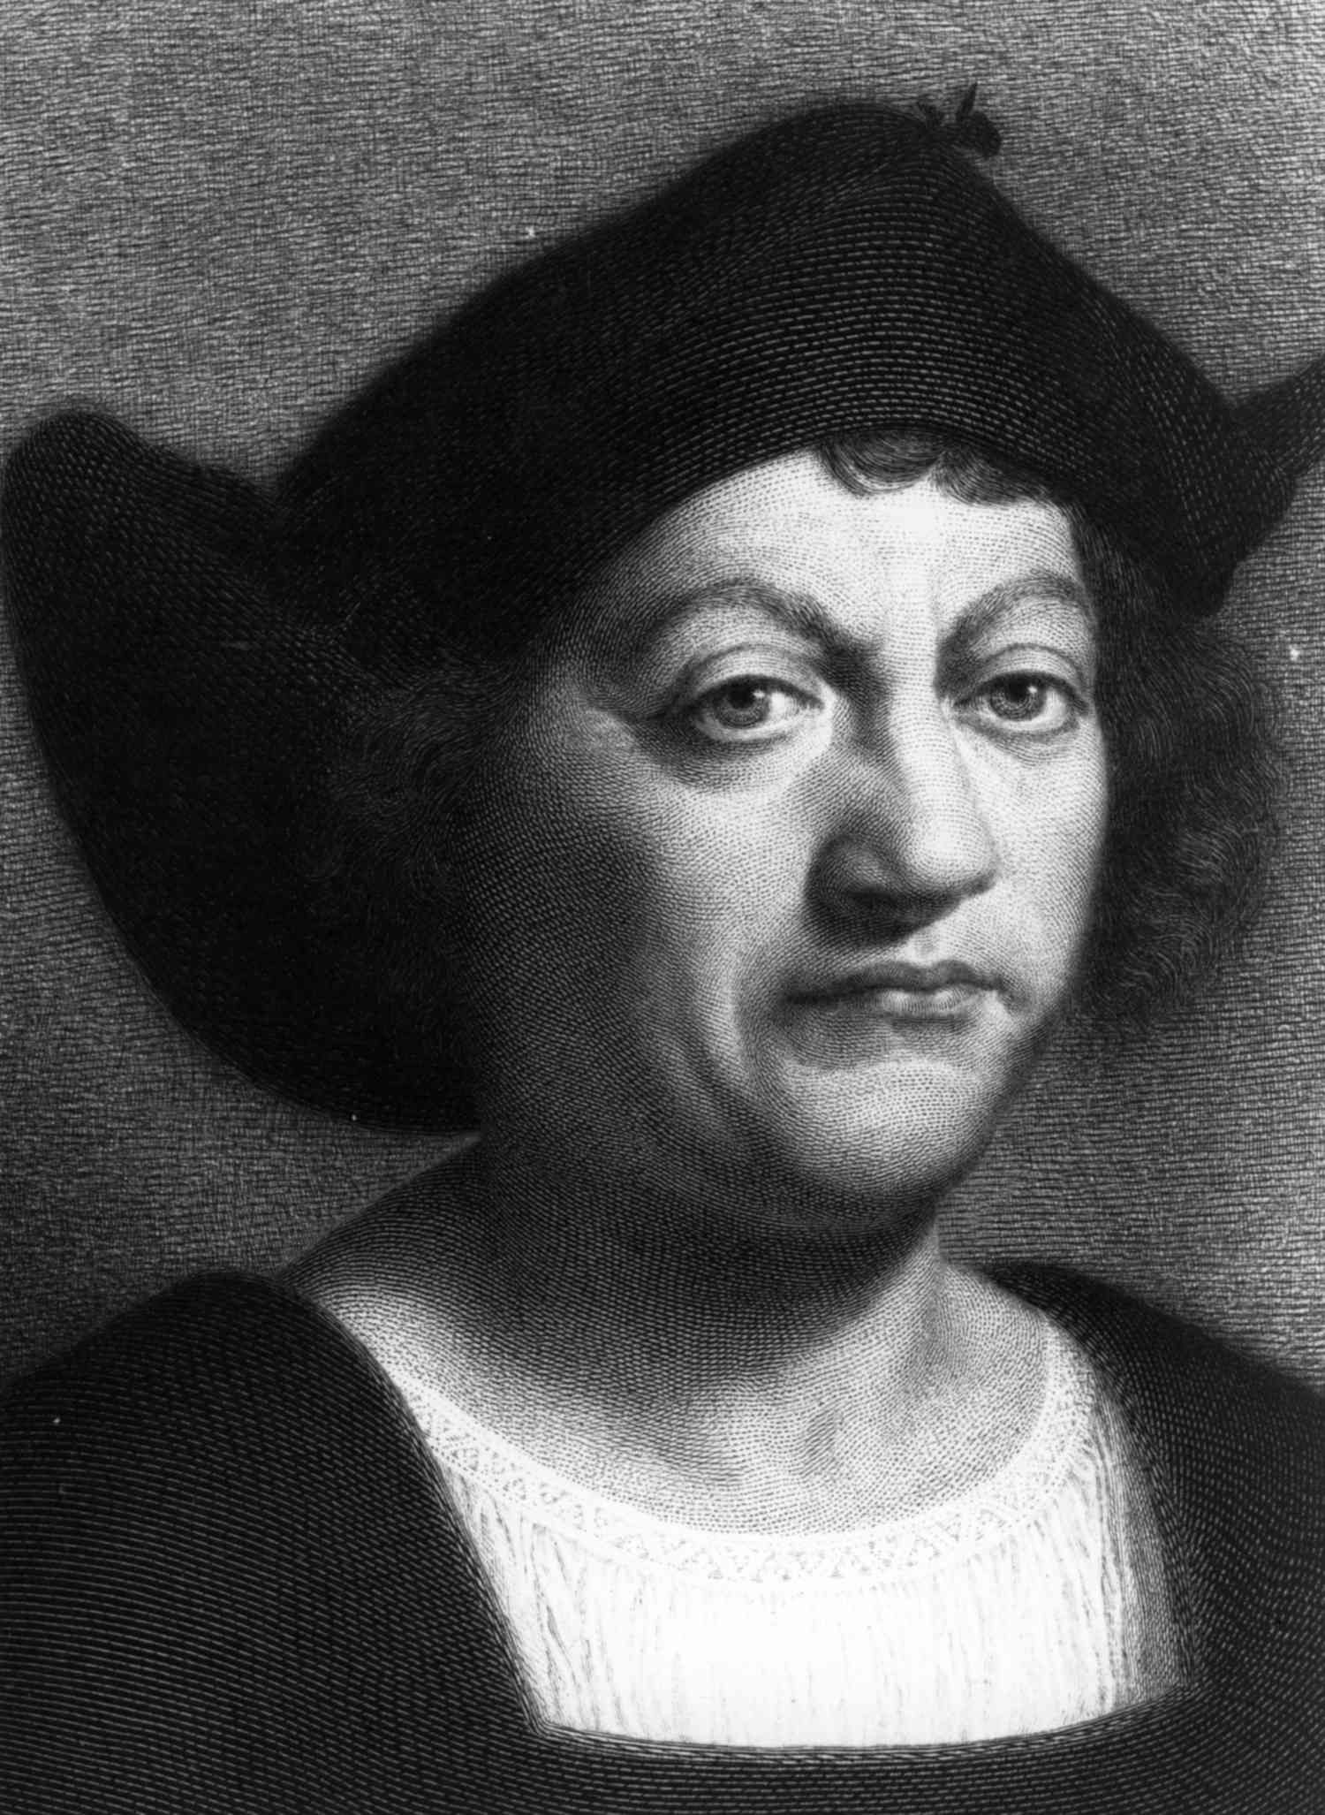
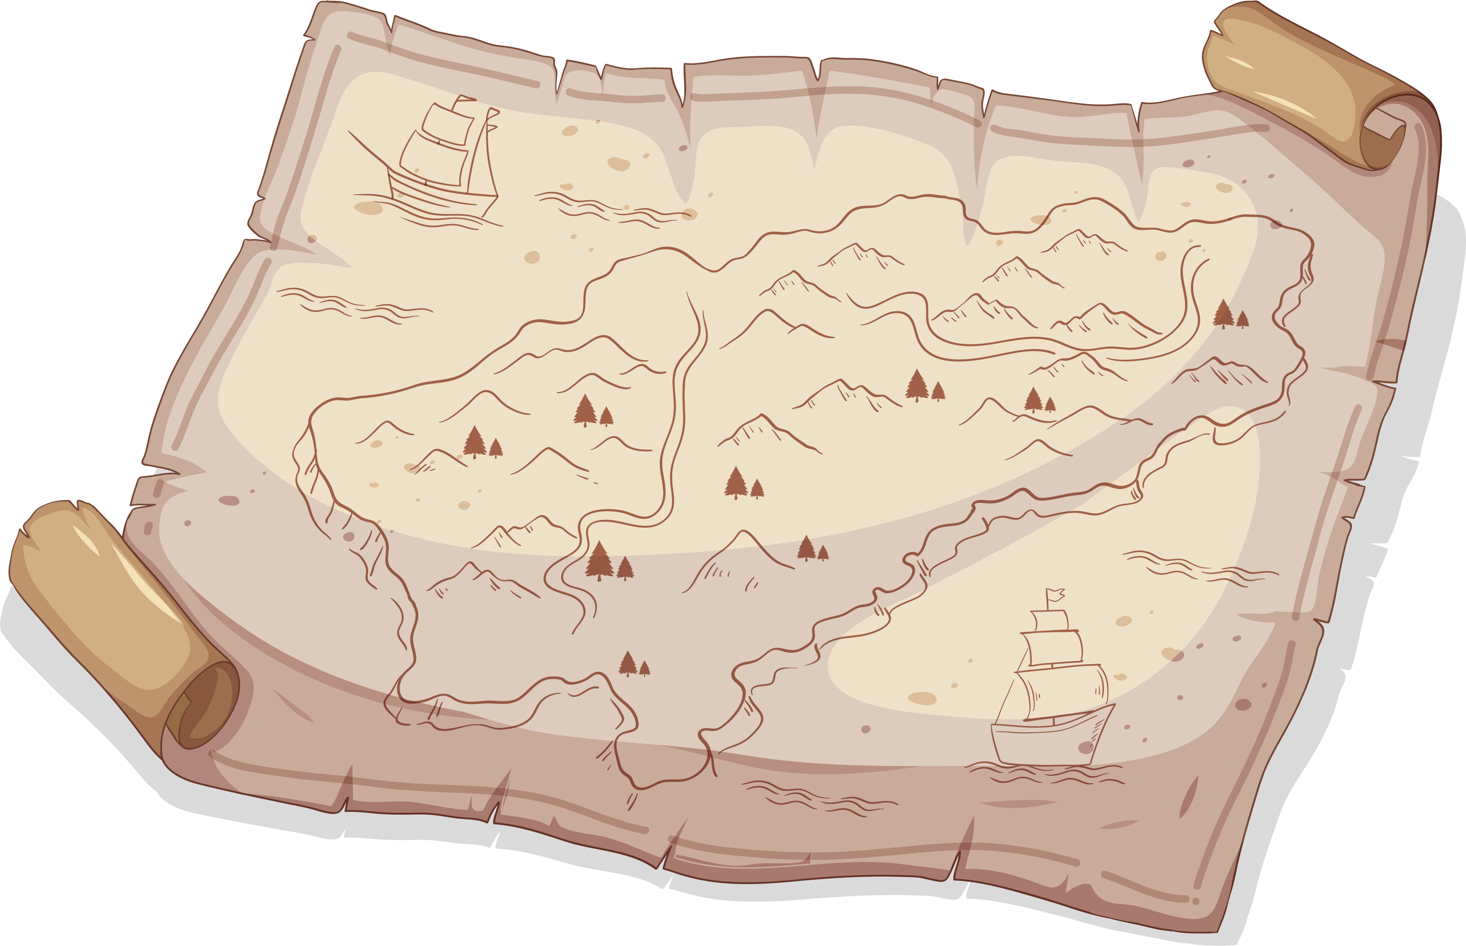
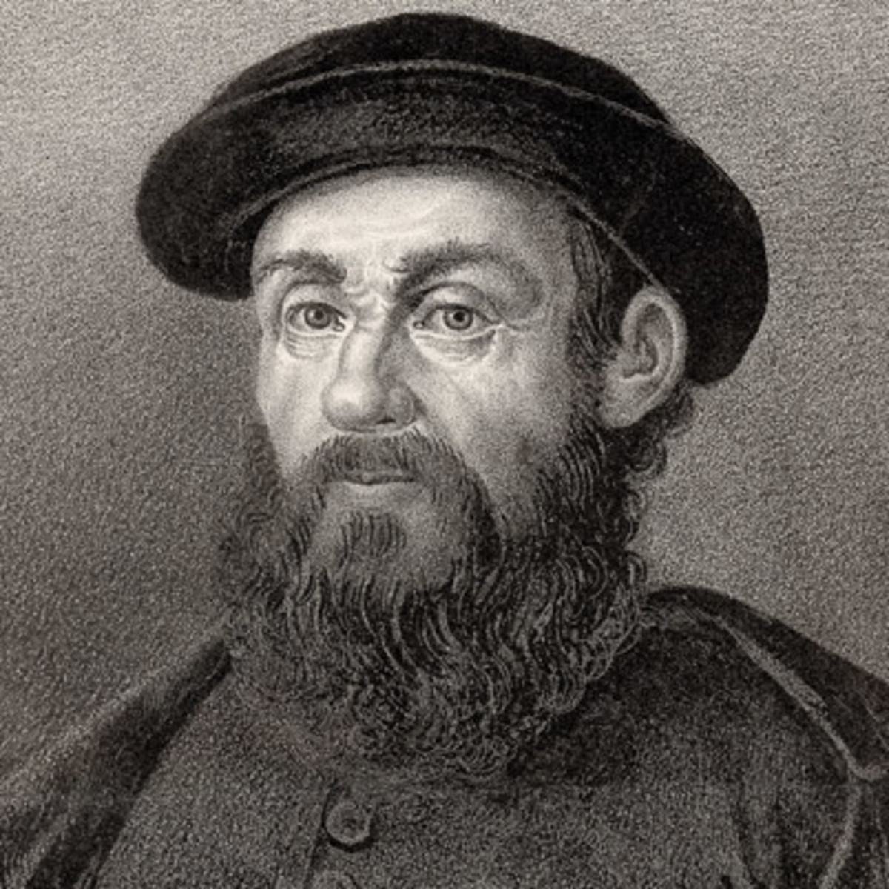
Maritime Exploration
Ferdinand Magellan
Christopher Columbus

Slide 3
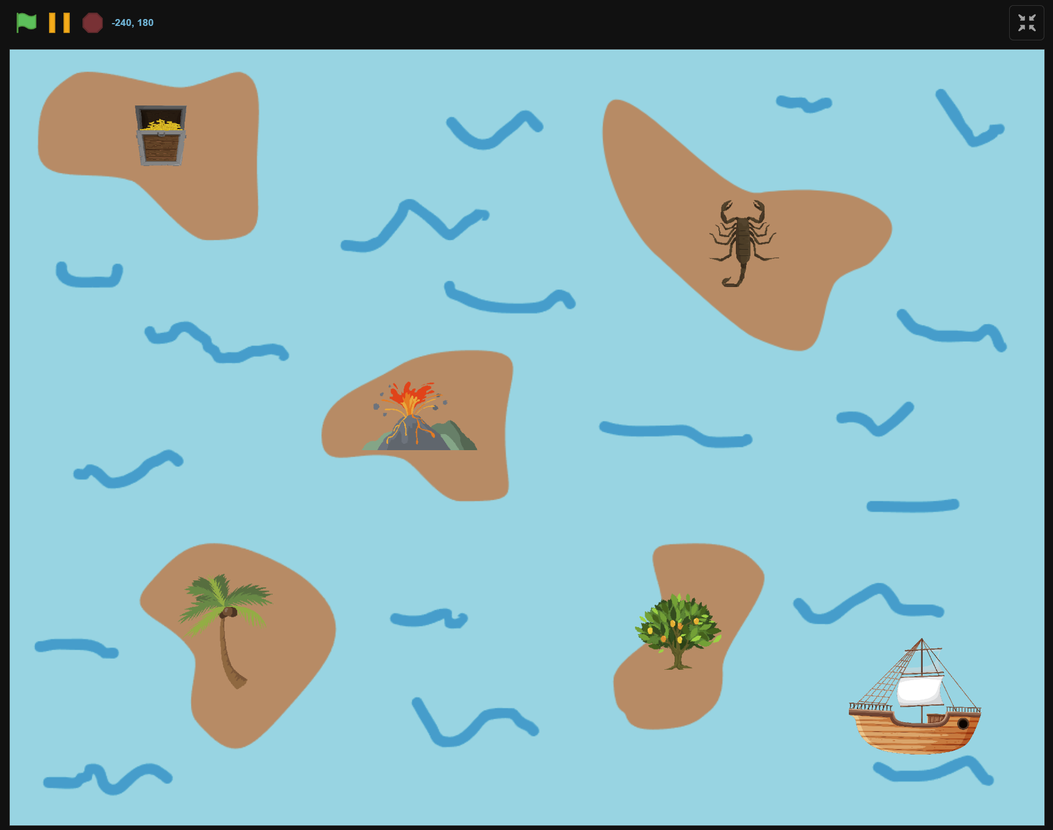
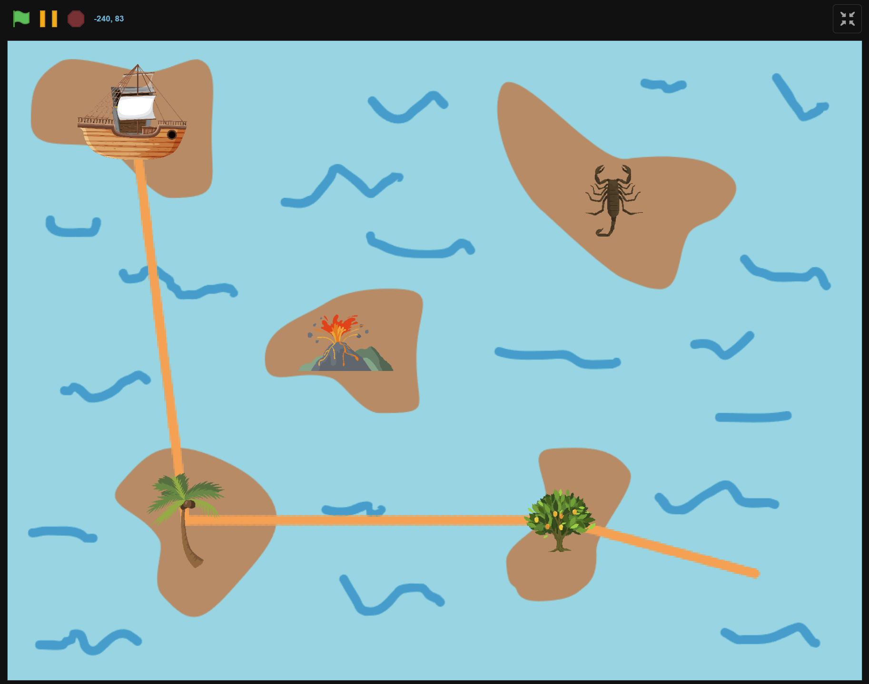
What we will Create…

Slide 4
What we learnt…
Sprites can say or think…

Slide 5
Exercises
Have fun with some of the other effects
Try different sprites and backdrops
Say and think differently
Checkout costumes of other sprites
Invent your own way of communication!

Slide 6
Thank you and see you in the next lesson!

